Slide 1
Discussion

Slide 2
Attribute Predictors
Binary and relative
Can benefit all discussed applications
Different features for each attribute, in each domain?
Learn the representation?
Recognition challenges remain
Especially when the definition of attributes is broadened
Slide credit: Devi Parikh

Slide 3
Role of Attributes
Deeper image understanding
Farhadi et al. 2010
Slide credit: Devi Parikh

Slide 4
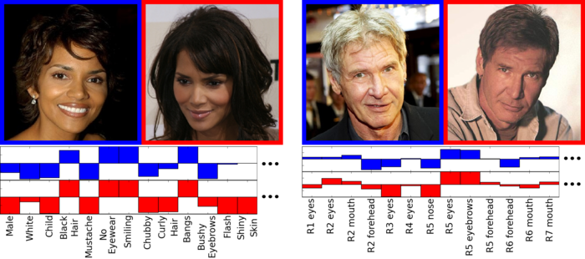
Role of Attributes
A better representation
Kumar et al., 2009
Slide credit: Devi Parikh

Slide 5
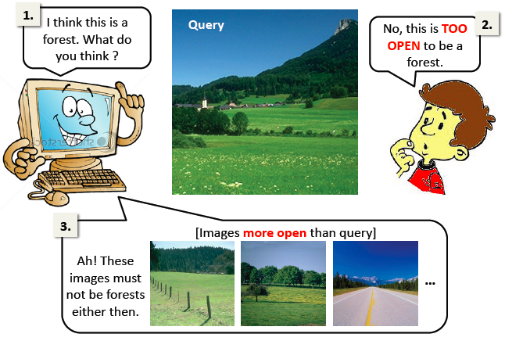
Role of Attributes
Human-machine communication
Human as a supervisor: active learning
Human as a user: search feedback
Understanding a phenomenon
Interpretable models
Characterizing failures
Parkash and Parikh, 2012
Slide credit: Devi Parikh

Slide 6
Role of Attributes
To deal with heavy tail distribution of categories
Co-existence constraints
If image has red car, car detector can be used to get training examples for red (vice versa)
Wang and Forsyth, 2009
Slide credit: Devi Parikh

Slide 7
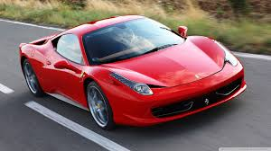
Definition of Attributes
Does it make sense to talk about them independent of the corresponding noun?
Red Car
Red Wine
Slide credit: Devi Parikh

Slide 8
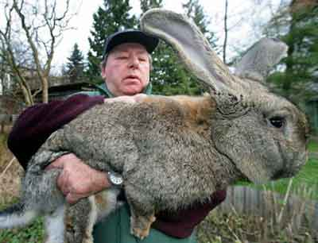
Definition of Attributes
Does it make sense to talk about them independent of the corresponding noun?
A tall rabbit is shorter than a short horse
Slide credit: Devi Parikh

Slide 9
Definition of Attributes
Does it make sense to talk about them independent of the corresponding noun?
A tall rabbit is shorter than a short horse
Are attributes less shareable them we think? How about parts?
How important is it to make sure attributes are learning the “right” thing?
Slide credit: Devi Parikh

Slide 10
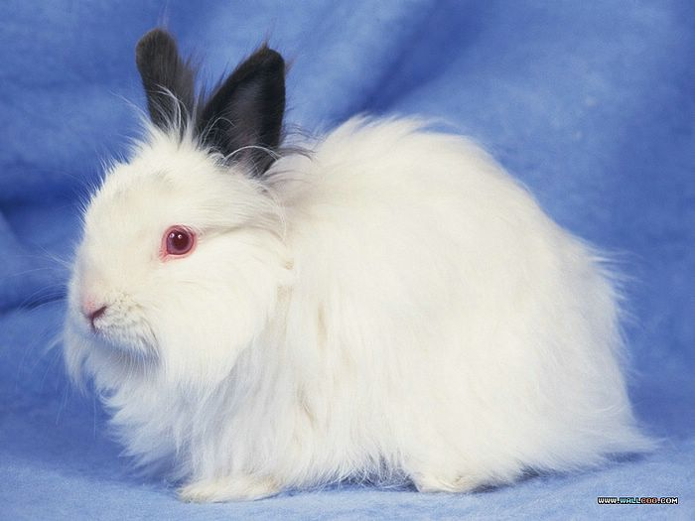
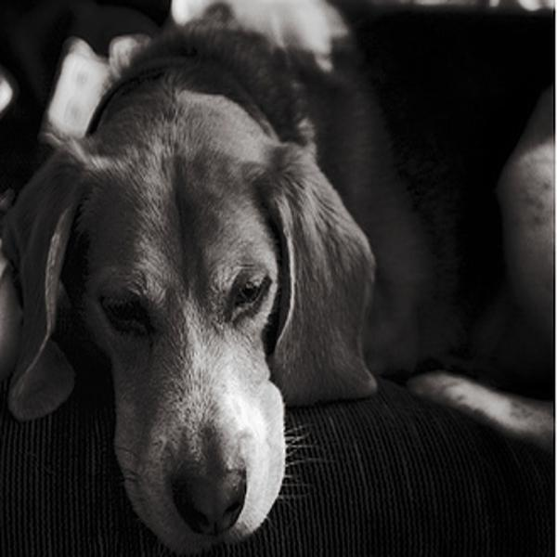
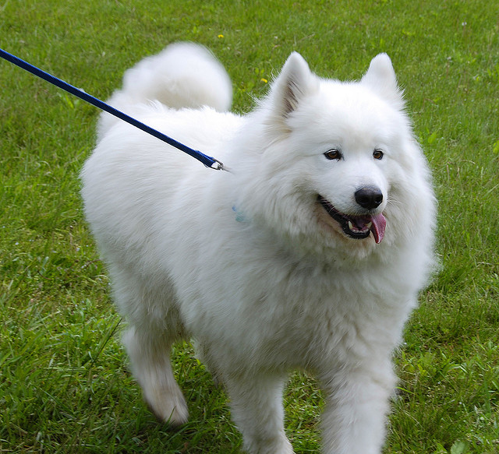
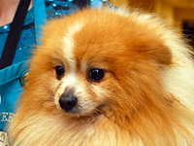
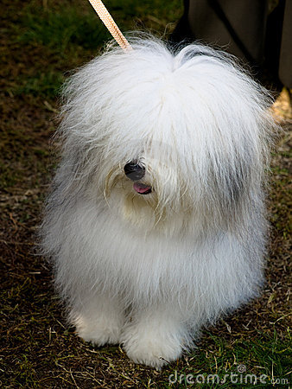
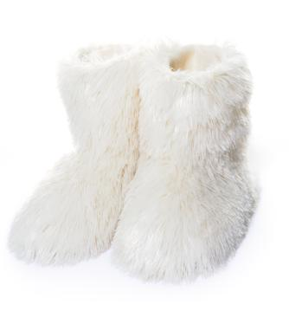
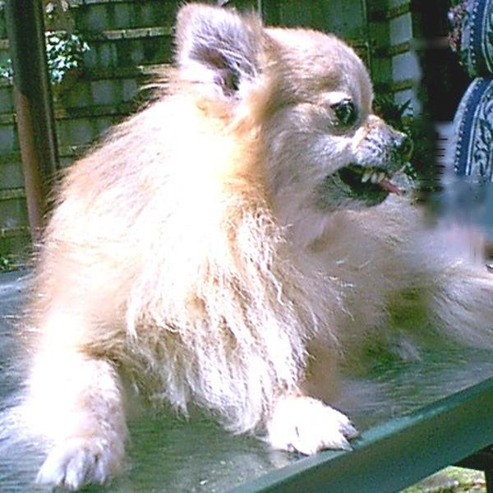
Definition of Attributes
Furry White Dog
Rastegari et al. CVPR 2013
White
Furry
Dog
White
Furry
Dog
White
Furry
Dog
…
White
Furry
Dog
Dog White
Furry
Slide credit: Devi Parikh

Slide 11
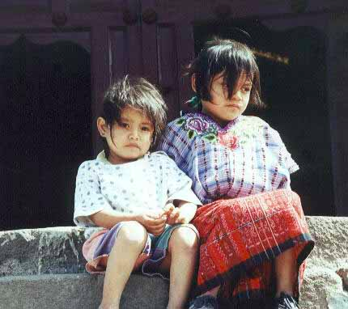
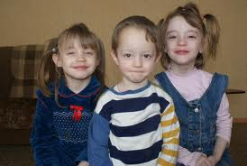
Definition of Attributes
Integrated treatment of relative and binary attributes
Not smiling
Smiling more than
Slide credit: Devi Parikh

Slide 12
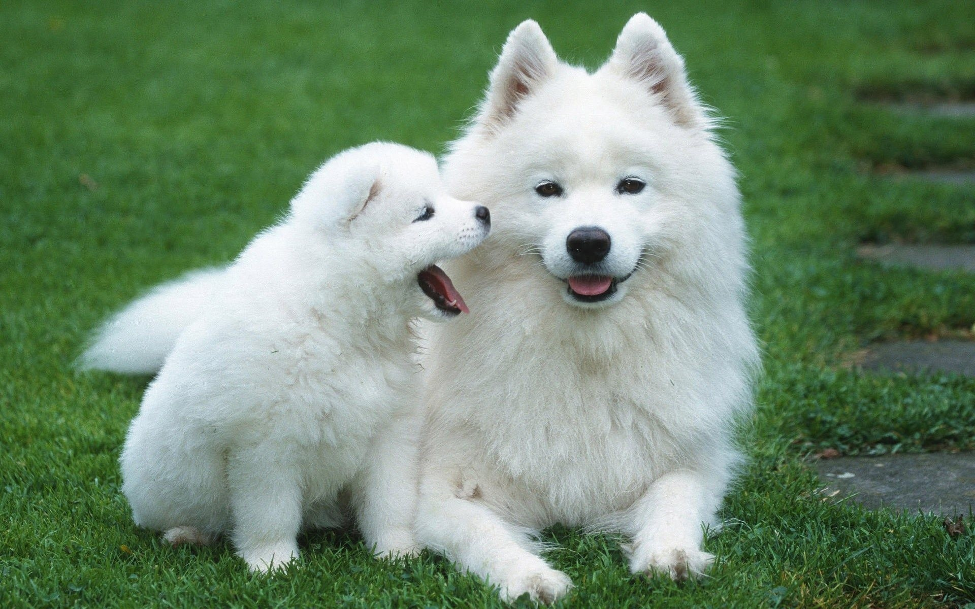
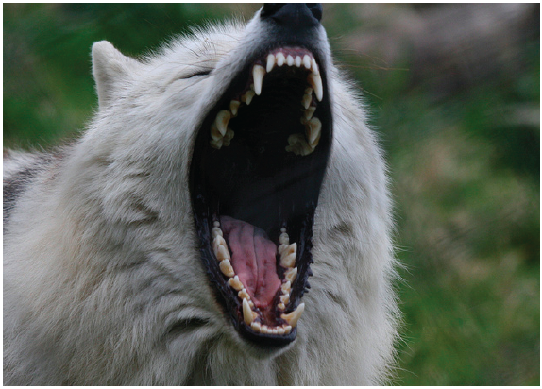
Definition of Attributes
Attributes are what humans care about
Image similarity in attribute space matches human perception better? Less annoying mistakes?
Estimate annoyance of mistakes using attributes?
Saliency: What do humans notice and name first?
White, furry
Scary, sharp teeth
Slide credit: Devi Parikh

Slide 13
(Some) Resources
Not comprehensive Continue to grow…

Slide 14
Faces
Public Figures Face Database (PubFig)
Kumar et al. 2009
200 celebrities (categories), ~60k images
73 binary attributes
Predictions, image URLs
http://www.cs.columbia.edu/CAVE/databases/pubfig/
Other pointers on above link
Slide credit: Devi Parikh

Slide 15
Faces (Relative)
Public Figures Face Database (PubFig)
Biswas and Parikh, 2013
60 celebrities (categories)
29 relative attributes
Annotations, predictions, predictors, features
http://filebox.ece.vt.edu/~parikh/attribute_feedback
Slide credit: Devi Parikh

Slide 16
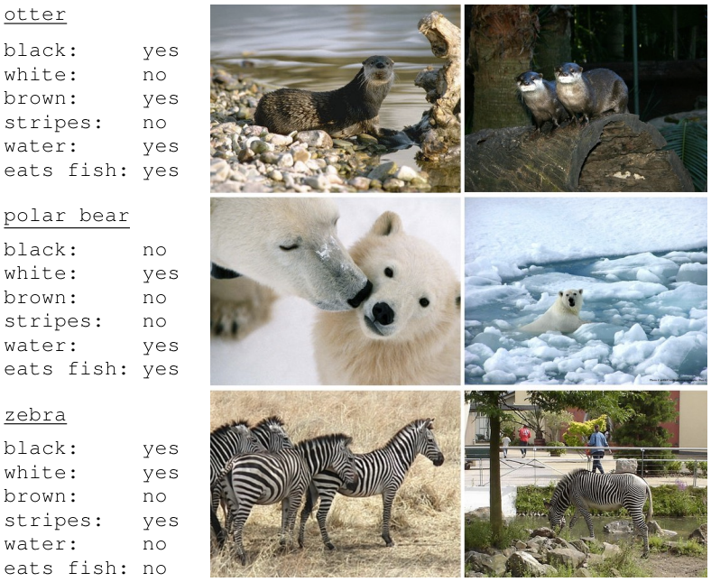
Animals
Animals With Attributes (AWA)
Lampert et al. 2009
50 categories, ~30k images
80 binary attributes
Annotations, outputs, predictors, code, features
http://attributes.kyb.tuebingen.mpg.de/
Slide credit: Devi Parikh

Slide 17
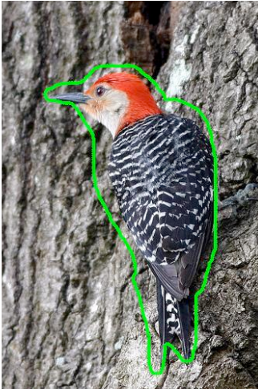
Birds
Caltech-UCSD Birds 200
Welinder et al. 2010
200 categories, ~6k images
25 multi-valued attributes (288 binary)
Annotations for bounding boxes of birds, rough segmentation, attributes, images
http://www.vision.caltech.edu/visipedia/CUB-200.html
Slide credit: Devi Parikh

Slide 18
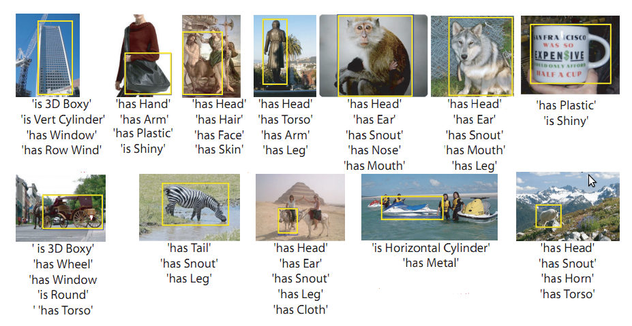
Objects
PASCAL 20 categories, VOC 2008
12 new categories (Yahoo!)
Farhadi et al. 2009
64 binary attributes
Images, annotations, features, predictions, code
http://vision.cs.uiuc.edu/attributes/
Slide credit: Devi Parikh

Slide 19
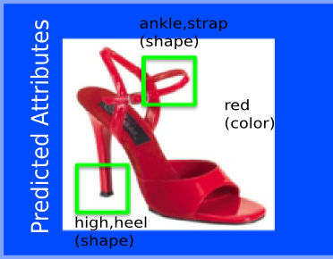
Products
Attribute Discovery Dataset
Berg et al. 2010
4 products: shoes, bags, earrings, ties
Image URLs, subcategory annotations, descriptions
http://tamaraberg.com/attributesDataset/
Slide credit: Devi Parikh

Slide 20
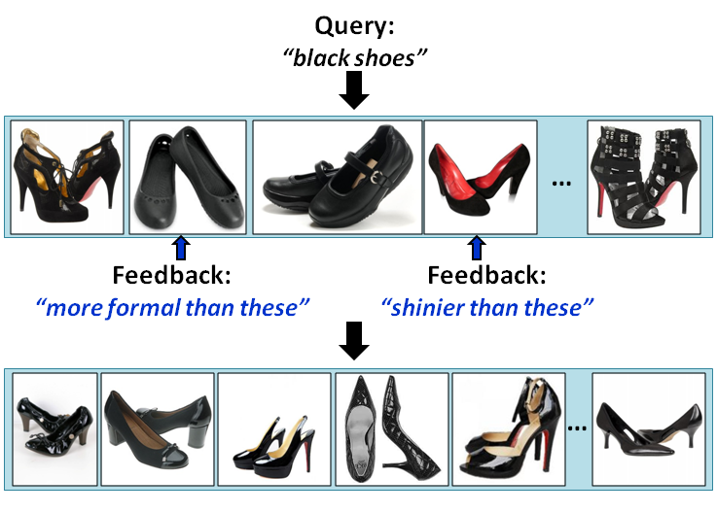
Shoes (Relative)
From Attributes Discovery Dataset
Kovashka et al. 2012
10 categories, ~15k images,
10 relative attributes
Annotations, features, predictions, code
http://vision.cs.utexas.edu/whittlesearch/
Slide credit: Devi Parikh

Slide 21
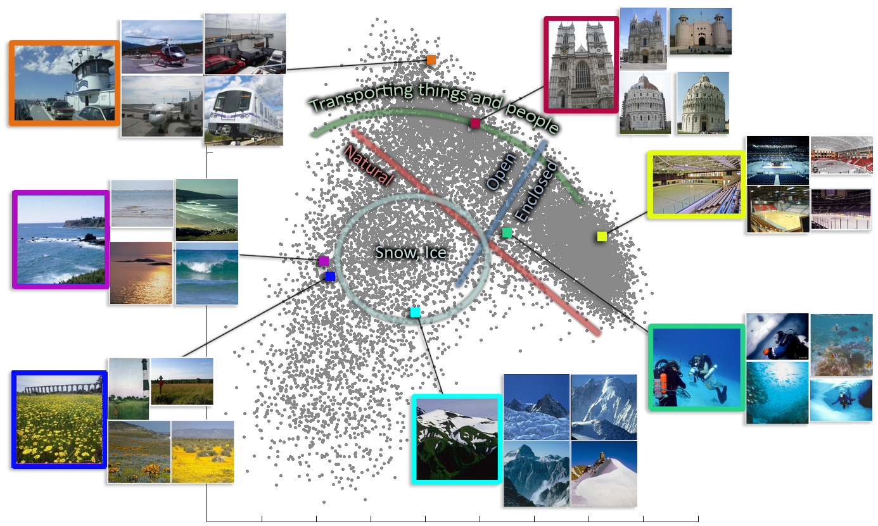
Scenes
SUN Attribute Dataset
Patterson and Hays, 2012
>700 categories, ~14k images
102 binary attributes
Annotations, images, features, code, predictions, predictors
http://cs.brown.edu/~gen/sunattributes.html
Slide credit: Devi Parikh

Slide 22
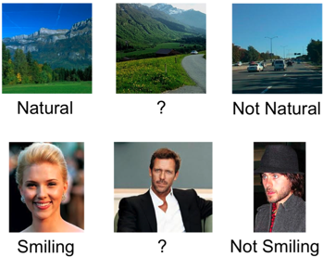
Scenes (Relative)
Outdoor Scene Recognition dataset of Oliva and Torralba, 2001
8 categories, ~3k images
6 attributes
Annotations (relative and binary), features, predictors, predictions, code
http://filebox.ece.vt.edu/~parikh/relative.html
Slide credit: Devi Parikh

Slide 23
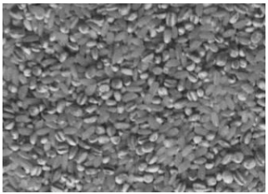
Texture (Relative)
Mathews et al. 2013
319 categories, 3828 images
11 attributes
Annotations, images
http://users.ecs.soton.ac.uk/tm1e10/texture.html

Slide 24
Summary: Attributes
Mid-level shared semantic visual representation
Offline uses to train better systems:
Learning with limited examples
Zero examples
A few examples
Provide rationale for category label
Provide feedback to a classifier’s mistake
Actively annotate attributes and objects
Semi-supervised learning to leverage big data
Slide credit: Devi Parikh

Slide 25
Summary: Attributes
Online uses of attributes
Search
Attributes for keywords-based search in images & video
Attributes for feedback
Human-in-the-loop interactive recognition
Attributes as image representations
Describing images
Discovering a vocabulary of attributes
Datasets, code, etc.
Slide credit: Devi Parikh

Slide 26
Thoughts?

