Slide 1
Attributes for deeper supervision in learning: Two examples
Annotator rationales for visual recognition
Active learning with objects and attributes
Slide credit: Kristen Grauman

Slide 2
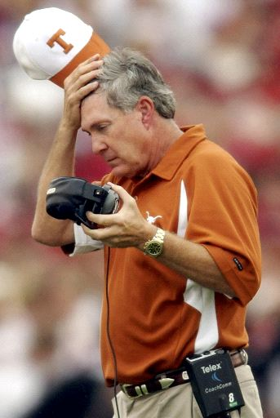
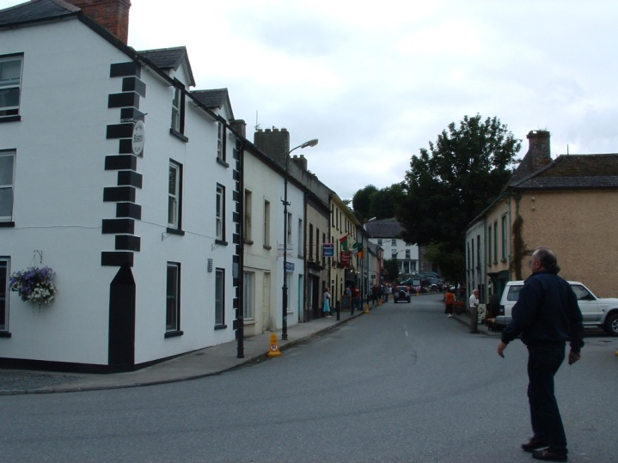
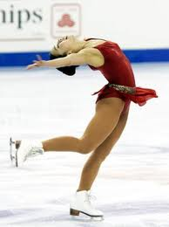
Complex visual recognition tasks
[Annotator Rationales for Visual Recognition. J. Donahue and K. Grauman, ICCV 2011]
Is the team winning?
Is it a safe route?
Is her form good?
How can you tell?
How can you tell?
How can you tell?
Main idea:
Solicit a visual rationale for the label.
Ask the annotator not just what, but also why.
Slide credit: Kristen Grauman

Slide 3
Soliciting visual rationales
Annotation task: Is her form good? How can you tell?
pointed toes
balanced
falling
knee angled
Spatial rationale
Attribute rationale
balanced
balanced
falling
pointed toes
pointed toes
knee angled
knee angled
Synthetic contrast example
Synthetic contrast example
[Annotator Rationales for Visual Recognition. J. Donahue and K. Grauman, ICCV 2011]
Slide credit: Kristen Grauman

Slide 4
Rationales’ influence on the classifier
balanced
Good form
pointed toes
balanced
Original training example
Bad form
pointed toes
Synthetic contrast example
Decision boundary refined in order to satisfy “secondary” margin
[Zaidan et al. Using Annotator Rationales to Improve Machine Learning for Text Categorization, NAACL HLT 2007]
Slide credit: Kristen Grauman

Slide 5
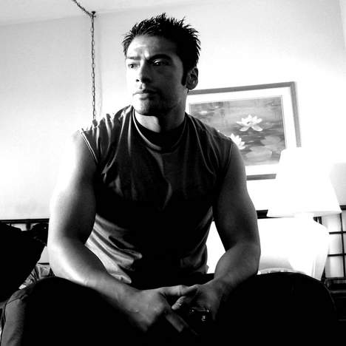
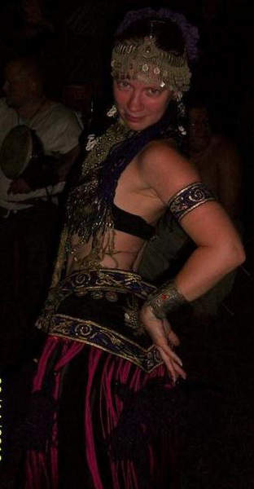
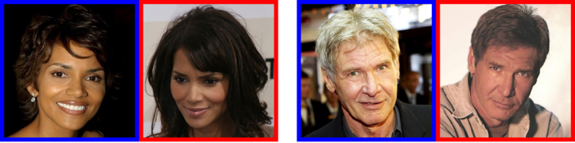
Rationale results
Scene Categories: How can you tell the scene category?
Hot or Not: What makes them hot (or not)?
Public Figures: What attributes make them (un)attractive?
Collect rationales from hundreds of MTurk workers.
[Annotator Rationales for Visual Recognition. J. Donahue and K. Grauman, ICCV 2011]
Slide credit: Kristen Grauman

Slide 6
Example rationales from MTurk
Scene categories
Hot or Not
PubFig Attractiveness
[Annotator Rationales for Visual Recognition. J. Donahue and K. Grauman, ICCV 2011]
Slide credit: Kristen Grauman

Slide 7
Rationale results
Mean AP
Scenes | Originals | +Rationales
Kitchen | 0.1196 | 0.1395
Living Rm | 0.1142 | 0.1238
Inside City | 0.1299 | 0.1487
Coast | 0.4243 | 0.4513
Highway | 0.2240 | 0.2379
Bedroom | 0.3011 | 0.3167
Street | 0.0778 | 0.0790
Country | 0.0926 | 0.0950
Mountain | 0.1154 | 0.1158
Office | 0.1051 | 0.1052
Tall Building | 0.0688 | 0.0689
Store | 0.0866 | 0.0867
Forest | 0.3956 | 0.4006
Hot or Not | Originals | +Rationales
Male | 54.86% | 60.01%
Female | 55.99% | 57.07%
PubFig | Originals | +Rationales
Male | 64.60% | 68.14%
Female | 51.74% | 55.65%
[Donahue & Grauman, ICCV 2011]

Slide 8
Rationale results
Scenes | Originals | +Rationales | Mutual information
Kitchen | 0.1196 | 0.1395 | 0.1202
Living Rm | 0.1142 | 0.1238 | 0.1159
Inside City | 0.1299 | 0.1487 | 0.1245
Coast | 0.4243 | 0.4513 | 0.4129
Highway | 0.2240 | 0.2379 | 0.2112
Bedroom | 0.3011 | 0.3167 | 0.2927
Street | 0.0778 | 0.0790 | 0.0775
Country | 0.0926 | 0.0950 | 0.0941
Mountain | 0.1154 | 0.1158 | 0.1154
Office | 0.1051 | 0.1052 | 0.1048
Tall Building | 0.0688 | 0.0689 | 0.0686
Store | 0.0866 | 0.0867 | 0.0866
Forest | 0.3956 | 0.4006 | 0.3897
Why not just use discriminative feature selection?
Mean AP
[Donahue & Grauman, ICCV 2011]

Slide 9
Recap: Annotator rationales
“Beyond labels” in recognition: when training, specify why, not just what
Human insight crucial for feature selection
Especially if exemplars are few + problem complex
Attributes offer language by which human can explain annotations
Slide credit: Kristen Grauman

Slide 10
Attributes for deeper supervision in learning: Two examples
Annotator rationales for visual recognition
Active learning with objects and attributes
Slide credit: Kristen Grauman

Slide 11
Active learning for image annotation
Labeled data
active
Annotator
?
Accuracy
Active request
passive
?
Unlabeled data
Current classifiers
Num labels added
Intent: better models, faster/cheaper
Slide credit: Kristen Grauman

Slide 12
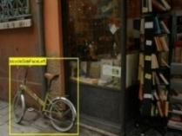
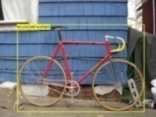
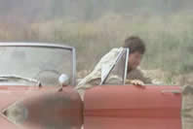
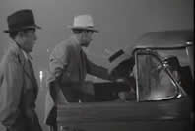
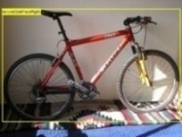
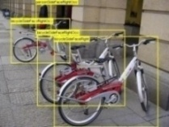
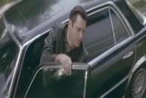
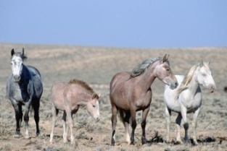
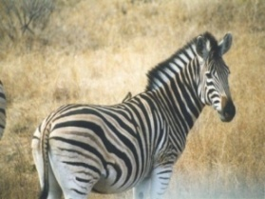
Active learning for image annotation
Previously, focus on soliciting object labels that will reduce uncertainty [Kapoor et al. ICCV 2007, Qi et al. CVPR 2008, Vijayanarasimhan & Grauman CVPR 2009, Joshi et al. CVPR 2009, Jain & Kapoor CVPR 2009, Jain et al. CVPR 2010,…]
Limitations:
Only narrow channel to provide human insight
Starts anew with each category learned
bicycle
get out of car
Slide credit: Kristen Grauman

Slide 13
Active learning with objects and attributes
[Actively Selecting Annotations Among Objects and Attributes. A. Kovashka et al., ICCV 2011]
Main idea:
Actively interleave requests for object and attribute labels
Minimize labeling effort thanks to key properties of attributes:
Attributes are shared between objects
Structure in attribute-attribute relationships
Slide credit: Kristen Grauman

Slide 14
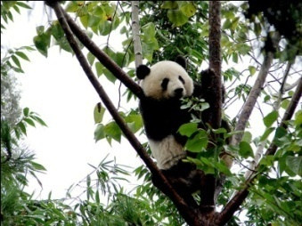
Active learning with objects and attributes
Labeled data
Annotator
Unlabeled data
What is this object?
Does this object have spots?
Current model
At each learning iteration, weigh impact of either type of label request
[Kovashka et al., ICCV 2011]
Slide credit: Kristen Grauman

Slide 15
Why are attributes useful for active learning of object categories?
Shared across objects
Providing labels for one attribute will affect more than one object category
[Kovashka et al., ICCV 2011]
Slide credit: Adriana Kovashka

Slide 16
Attributes shared across objects
aeroplane
aeroplane
aeroplane
aeroplane
aeroplane
bicycle
bicycle
boat
bicycle
bicycle
boat
boat
boat
boat
bus
bus
car
car
car
boat
car
car
car
car
car
car
car
car
car
motorbike
motorbike
motorbike
motorbike
train
train
train
[Kovashka et al., ICCV 2011]
Slide credit: Adriana Kovashka

Slide 17
Attributes shared across objects
aeroplane
aeroplane
aeroplane
aeroplane
aeroplane
bicycle
bicycle
boat
bicycle
bicycle
boat
boat
boat
boat
bus
bus
car
car
car
boat
car
car
car
car
car
car
car
car
car
motorbike
wheel
motorbike
motorbike
motorbike
train
train
train
[Kovashka et al., ICCV 2011]
Slide credit: Adriana Kovashka

Slide 18
Attributes shared across objects
aeroplane
aeroplane
aeroplane
aeroplane
aeroplane
bicycle
bicycle
boat
bicycle
bicycle
boat
boat
boat
boat
bus
bus
car
car
car
boat
car
car
car
car
car
car
car
car
car
motorbike
plastic
motorbike
motorbike
motorbike
train
train
train
[Kovashka et al., ICCV 2011]
Slide credit: Adriana Kovashka

Slide 19
Attributes shared across objects
aeroplane
aeroplane
aeroplane
aeroplane
aeroplane
bicycle
bicycle
boat
bicycle
bicycle
boat
boat
boat
boat
bus
bus
car
car
car
boat
car
car
car
car
car
car
car
car
car
motorbike
3D boxy
motorbike
motorbike
motorbike
train
train
train
[Kovashka et al., ICCV 2011]
Slide credit: Adriana Kovashka

Slide 20
Why are attributes useful for active learning of object categories?
Shared across objects
Providing labels for one attribute will affect more than one object category
Attribute relationships are informative
Learning one attribute can reduce the annotation effort for another
[Kovashka et al., ICCV 2011]
Slide credit: Adriana Kovashka

Slide 21
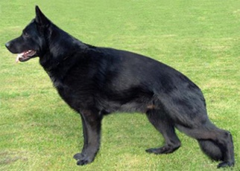
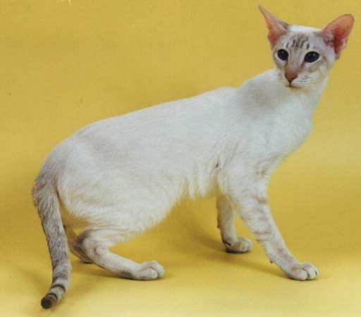
Attribute relationships
lean
active
fast
smart
furry
tail
quadrupedal
walks
domestic
[Kovashka et al., ICCV 2011]
Slide credit: Adriana Kovashka

Slide 22
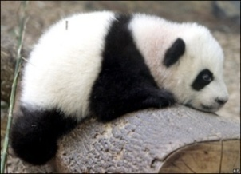
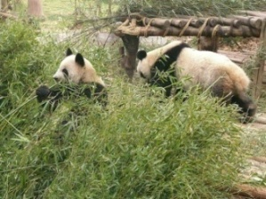
Object-Attribute Model
“A Discriminative Latent Model of Object Classes and Attributes” (Wang & Mori, ECCV 2010)
Bat?
…
Giant panda?
…
Zebra?
Object classifier
Attribute classifiers
Attribute-attribute relationships
Object-attribute relationships
Black / not black?
White / not white?
Big / not big?
Furry / not furry?
…
Saddle
Wool
Rein
Furry
Snout
Horn
“Horse”
brown = 0
legs = 1
horns = 0
Slide credit: Adriana Kovashka

Slide 23
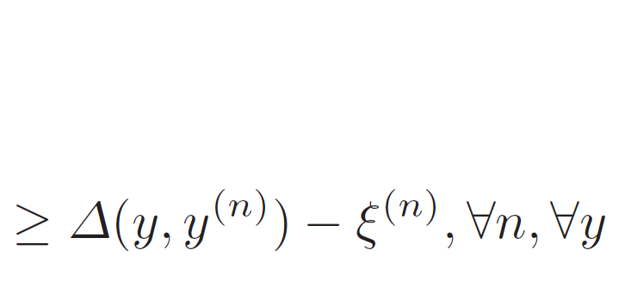
Structured SVM with Latent Variables
Features depend on class label:
To predict class label:
Learning with observed attributes:
Image
Hidden attribute labels
Object label
true object and attribute labels
any object and inferred attribute labels
cost of misclassification
“Learning Structural SVMs with Latent Variables” (Yu and Joachims, ICML 2009)
Slide credit: Adriana Kovashka

Slide 24
Object-Attribute Model
Define latent SVM to encode all relationships:
(V, E) = graph of attribute-attribute relationships
Image
Hidden attribute labels
Object label
attribute – attribute relationships
object – attribute relationships
object
attributes
“A Discriminative Latent Model of Object Classes and Attributes” (Wang & Mori, ECCV 2010)
Slide credit: Adriana Kovashka
Notes:
24

Slide 25
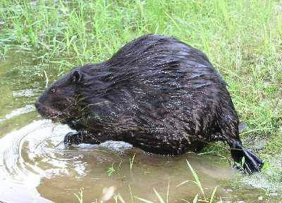
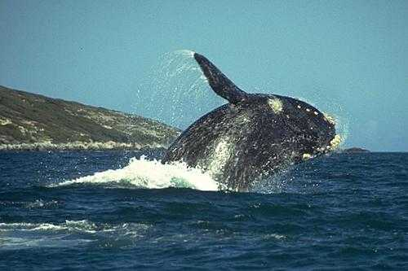
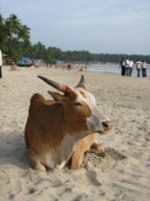
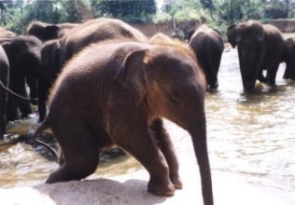
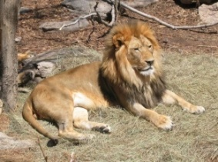
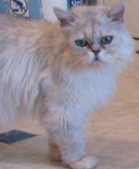
Model: Object Classifier
Probability that image x has object label y
Obtained from multi-class SVM
Ignoring attributes
beaver
blue whale
cow
elephant
lion
persian cat
Object SVM
“A Discriminative Latent Model of Object Classes and Attributes” (Wang & Mori, ECCV 2010)
Slide credit: Adriana Kovashka

Slide 26
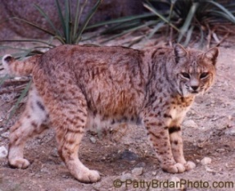
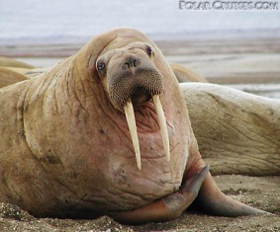
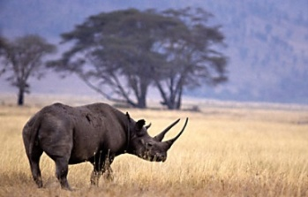
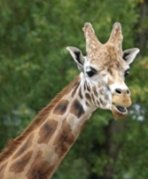
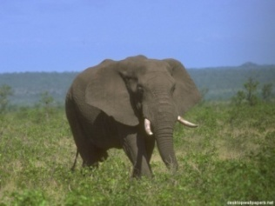
Model: Attribute Classifiers
Probability that j^{th} attribute is h_{j}
Obtained from binary SVM for attribute j
Ignoring object labels
furry = 1
furry = 1
furry = 0
hooves = 1
hooves = 1
hooves = 0
Attribute SVMs
“A Discriminative Latent Model of Object Classes and Attributes” (Wang & Mori, ECCV 2010)
Slide credit: Adriana Kovashka

Slide 27
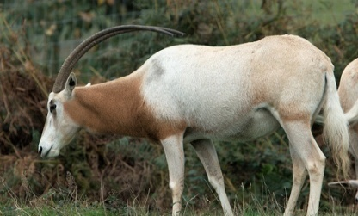
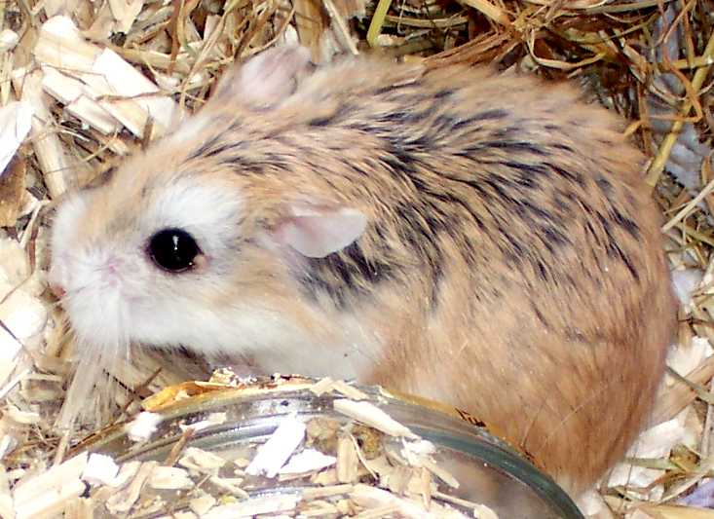
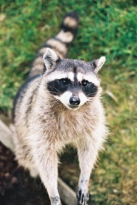
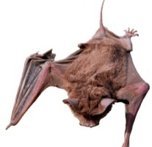
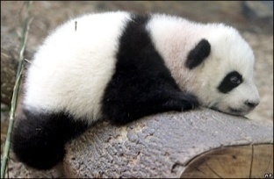
Model: Attribute-Attribute Relations
Binary vector of length 4
1 in one entry denotes which attributes present
Model relations of most informative attributes pairs only
<vegetation=1, grazer=1>
= [1 0 0 0]
<vegetation=1, grazer=1>
= [1 0 0 0]
<vegetation=1, grazer=0>
= [0 1 0 0]
<black=1, white=0>
= [0 1 0 0]
<black=0, white=1>
= [0 0 1 0]
<black=1, white=1>
= [1 0 0 0]
Attribute-attribute relationships
“A Discriminative Latent Model of Object Classes and Attributes” (Wang & Mori, ECCV 2010)
Slide credit: Adriana Kovashka

Slide 28
Model: Object-Attribute Relations
Reflects frequency of object being y and j^{th} attribute being h_{j}
“Horse”
brown = 0
legs = 1
horns = 0
“A Discriminative Latent Model of Object Classes and Attributes” (Wang & Mori, ECCV 2010)
Slide credit: Adriana Kovashka

Slide 29
Object-Attribute Model: Testing
Use linear programming to efficiently find best attribute labels assignment, given an object label
To predict the object label y* for image x:
“A Discriminative Latent Model of Object Classes and Attributes” (Wang & Mori, ECCV 2010)
Slide credit: Adriana Kovashka

Slide 30
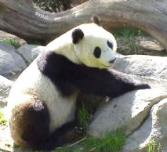
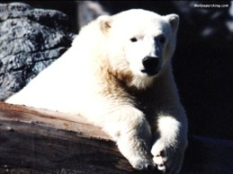
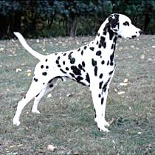
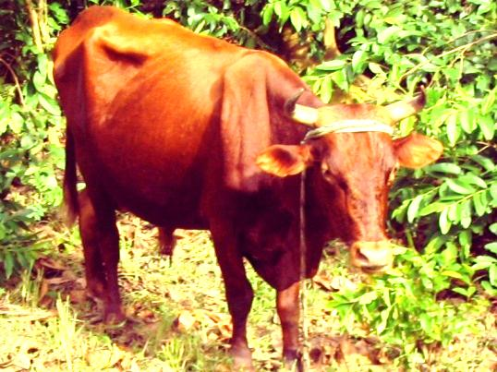
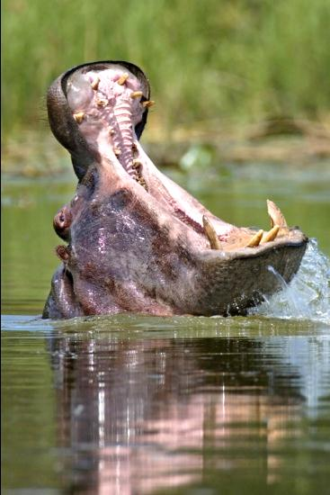
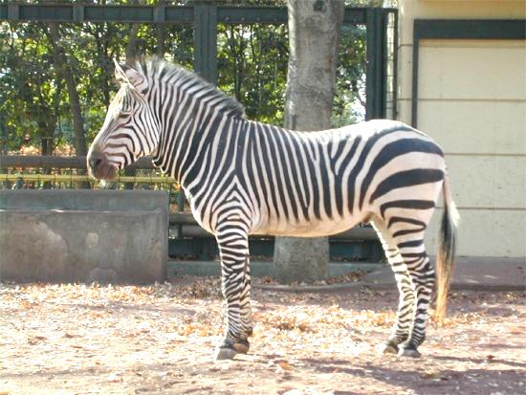
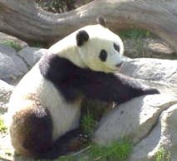
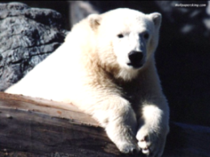
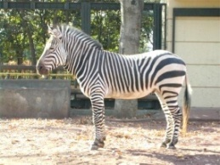
Active learning with objects and attributes
object classifiers
What is this object?
attribute classifiers
Labeled data
Annotator
attribute relations
Unlabeled data
Does this object have spots?
attribute-object relations
Current model
Two possible queries on an unlabeled image
Model components most influenced by potential responses
Slide credit: Kristen Grauman

Slide 31
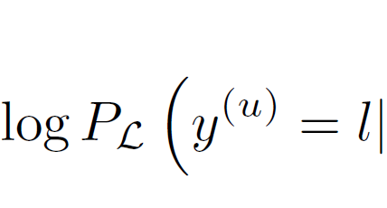
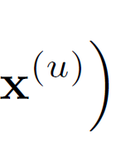
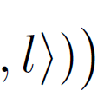
Entropy-based selection function
Object class entropy on labeled + unlabeled sets
Seek maximum entropy reduction (min expected H)
possible object labels
c
target
training data
c
entropy if label y=l added
Slide credit: Adriana Kovashka

Slide 32
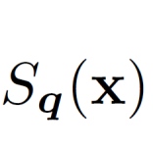
Entropy-based selection function
Expected entropy for object and attributes
Best <image, label> choice:
object label
object label
attribute label
attribute label
Both estimate entropy of object predictions --- comparable!
Slide credit: Adriana Kovashka

Slide 33
antelope
horns = 1
white = 1
Selected questions to human
object is?
object classifier
…
bobcat
stripes = 1
attribute classifiers
…
dalmatian
spots = 1
attribute-attribute
relationships
has stripes?
…
Current
model
panda
stripes = 0
object-attribute
relationships
…
…
is blue?
whale
lean = 0
…
….
siamese cat
blue = 0
object is?
Update model with new labels
…
Initial labeled data
Sorted <img, label request>
pairs from unlabeled data
Slide credit: Kristen Grauman

Slide 34
Animals with Attributes – 1 (1003 unlabeled, 732 test)
Animals with Attributes – 2 (1002 unlabeled, 993 test)
aYahoo (703 unlabeled, 200 test)
aPascal (903 unlabeled, 287 test)
hamster hippopotamus horse humpback whale killer whale
tiger walrus weasel wolf zebra
centaur donkey goat monkey wolf zebra
aeroplane bicycle boat bus car motorbike train
Slide credit: Adriana Kovashka

Slide 35
Active learning with objects and attributes Entropy reduction
Slide credit: Adriana Kovashka

Slide 36
Active learning with objects and attributes Entropy reduction
Slide credit: Adriana Kovashka

Slide 37
Active learning with objects and attributes Entropy reduction
Faster reduction in entropy when able to interleave object and attribute label requests
Slide credit: Adriana Kovashka

Slide 38
Active learning with objects and attributes Entropy reduction
Actively label only 4% of total available image data with objects/attributes→ 75% of max possible accuracy.
Actively request only object labels → only 67% of max accuracy.
Faster reduction in entropy when able to interleave object and attribute label requests
Slide credit: Adriana Kovashka

Slide 39
What labels are requested?
Slide credit: Adriana Kovashka

Slide 40
What labels are requested?
“What is this object?”
“Does it swim?”
“Does it live in the ocean?”
“Does it walk?”
“Is it an arctic animal?”
“What is this object?”
Initial training set
Slide credit: Adriana Kovashka

Slide 41
Recap: Active learning with objects and attributes
Represent interactions between objects and attributes
Propagate expected impact of annotations through entire model
Exploit shared nature of attributes: enables form of joint multi-class active learning
Once again, attributes offer broader channel for human insight during offline training
Slide credit: Kristen Grauman

Slide 42
Summary: Attributes for “offline” learning
Zero-shot learning
Feedback to classifiers about mistakes
Constrained semi-supervised learning
Adopting unseen examples
Annotator rationales
Active label requests for objects and attributes
Slide credit: Kristen Grauman

