Slide 1

Bringing Semantics Into Focus Using Visual Abstraction
Larry Zitnick Devi Parikh
Microsoft Research Virginia Tech

Slide 2
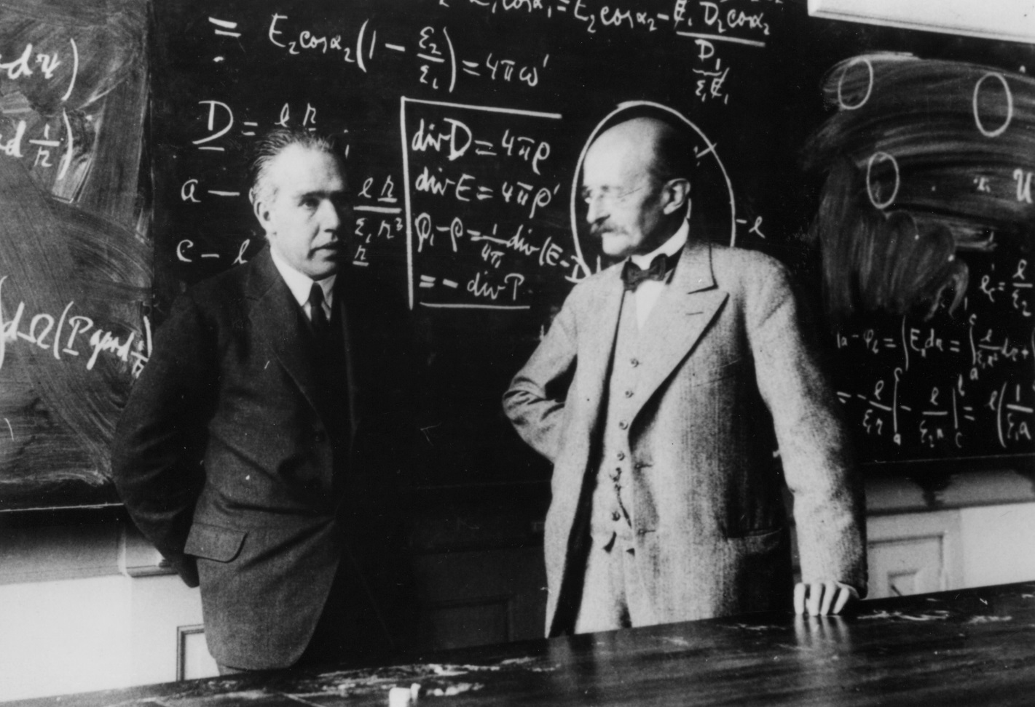
Two professors converse in front of a blackboard.

Slide 3
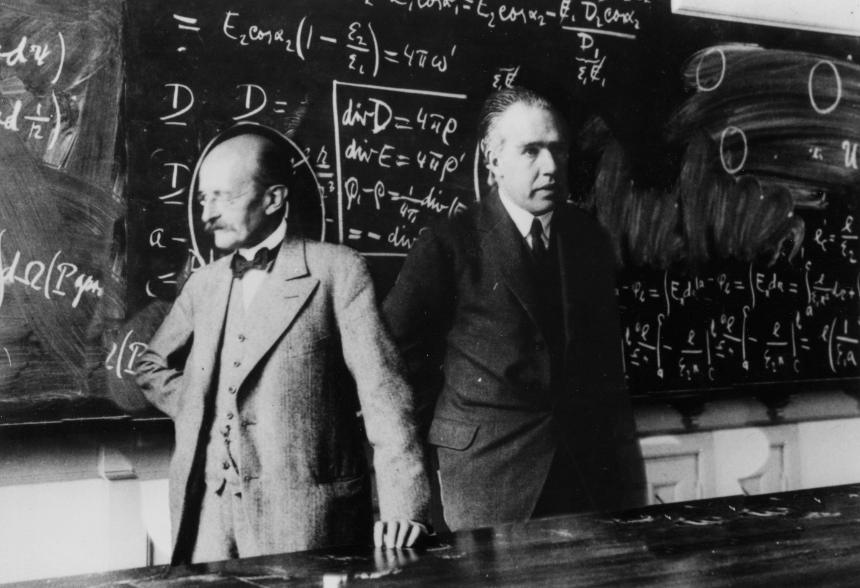
Two professors stand in front of a blackboard.

Slide 4
Two professors converse in front of a blackboard.

Slide 5
Face
Person
Face
Person
Cat
Dining table
Felzenszwalb, 2010

Slide 6
Wall
Receding hairline
Equation
Person
Person
Gaze
Mustache
Gaze
Tie
Equation
Tie
Table

Slide 7
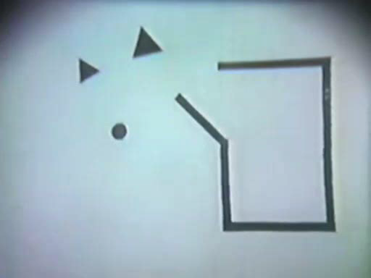
Apparent Behavior, Heider and Simmel, 1944

Slide 8
Is photorealism necessary?

Slide 9
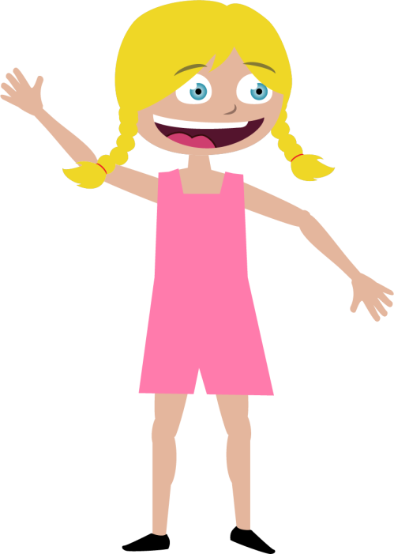

Jenny
Mike

Slide 10
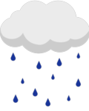


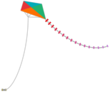


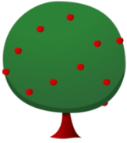







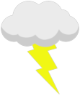




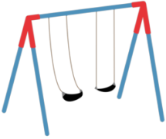


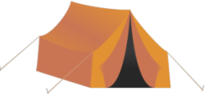




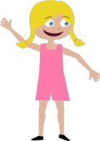
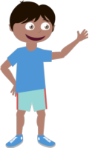


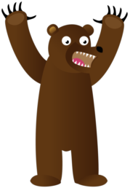





















Slide 11











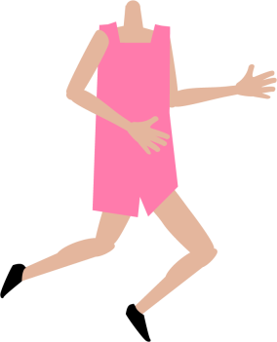


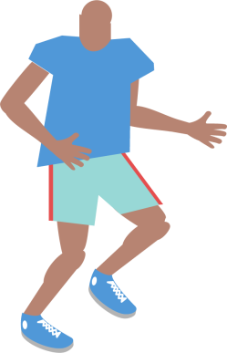
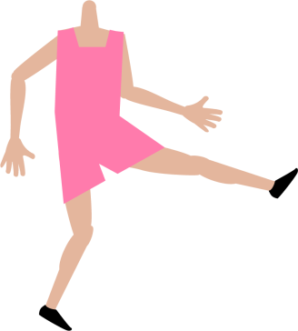
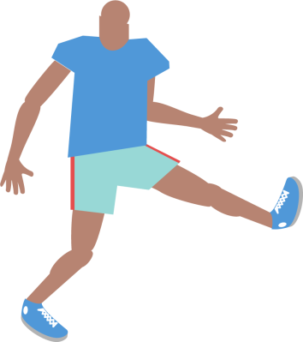




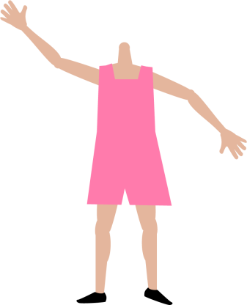
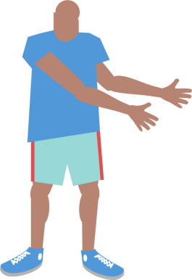


Slide 12
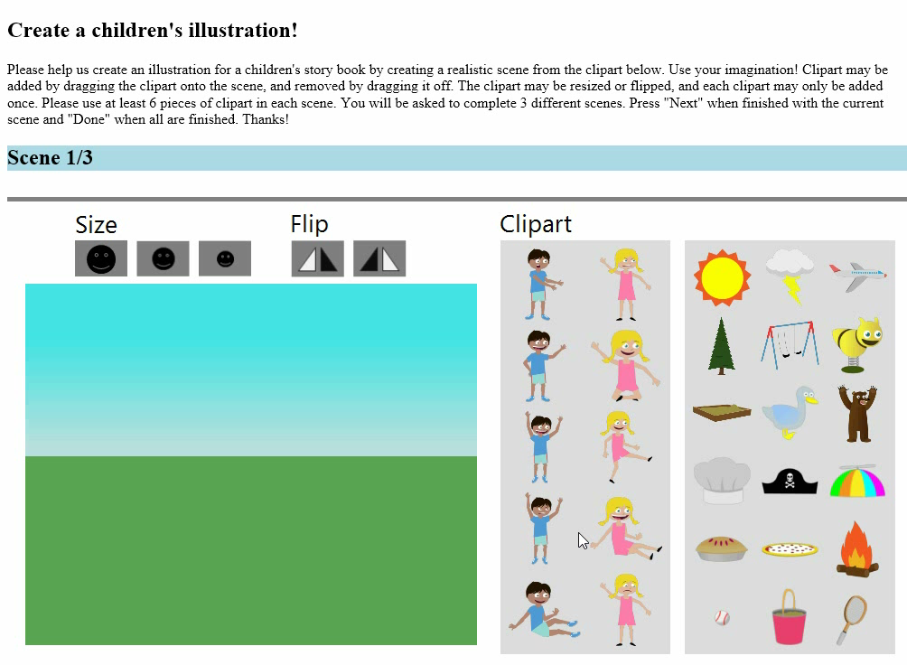
How do we generate scenes?

Slide 13
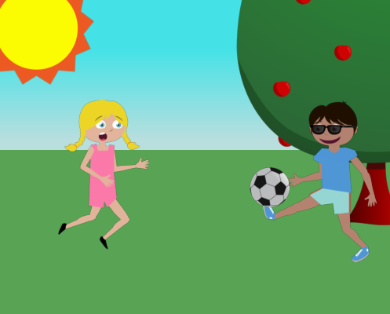
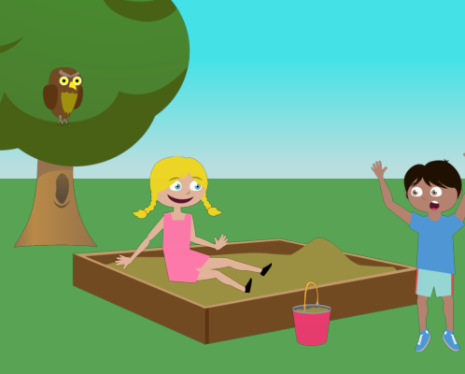
Generating sentences
Jenny loves to play soccer but she is worried that Mike will kick the ball too hard.
Mike and Jenny play outside in the sandbox. Mike is afraid of an owl that is in the tree.

Slide 14
Previous work
Sentence generation
Farhadi et al., Every picture tells a story: Generating sentences from images. ECCV, 2010.
Ordonez et al., Im2text: Describing images using 1 million captioned photographs. NIPS, 2011.
Yang et al., Corpus-guided sentence generation of natural images. EMNLP, 2011.
Kulkarni et al., Baby talk: Understanding and generating simple image descriptions. CVPR, 2011.
Kuznetsova et al., Collective Generation of Natural Image Descriptions. ACL, 2012.
Gupta et al., Choosing Linguistics over Vision to Describe Images. AAAI, 2012.
Mitchell et al., Midge: Generating Image Descriptions From Computer Vision Detections. EACL, 2012.
Nouns
Spain and Perona, Measuring and predicting object importance. IJCV 2011.
Hwang and Grauman, Learning the relative importance of objects… IJCV, 2011.
Adjectives, prepositions
Gupta and Davis, Beyond nouns …, ECCV, 2008.
Farhadi et al., Describing objects by their attributes. CVPR, 2009.
Berg et al., Automatic attribute discovery and characterization from noisy web data. ECCV 2010.
Parikh and Grauman. Relative attributes. ICCV 2011.
Verbs
Yao and Fei-Fei, Modeling mutual context … in human-object interaction activities. CVPR 2010.
Sadeghi and Farhadi, Recognition using visual phrases. CVPR 2011.

Slide 15
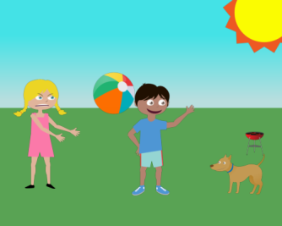
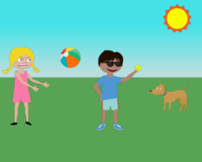
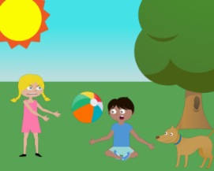
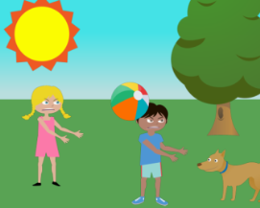
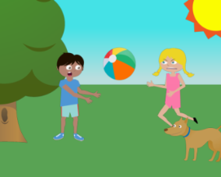
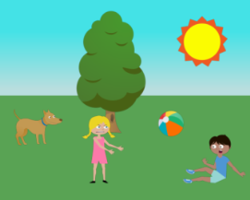
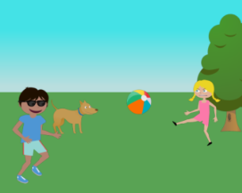
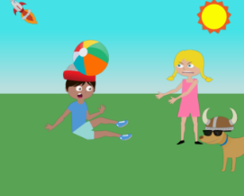
Generating data
“Jenny just threw the beach ball angrily at Mike while the dog watches them both.”

Slide 16
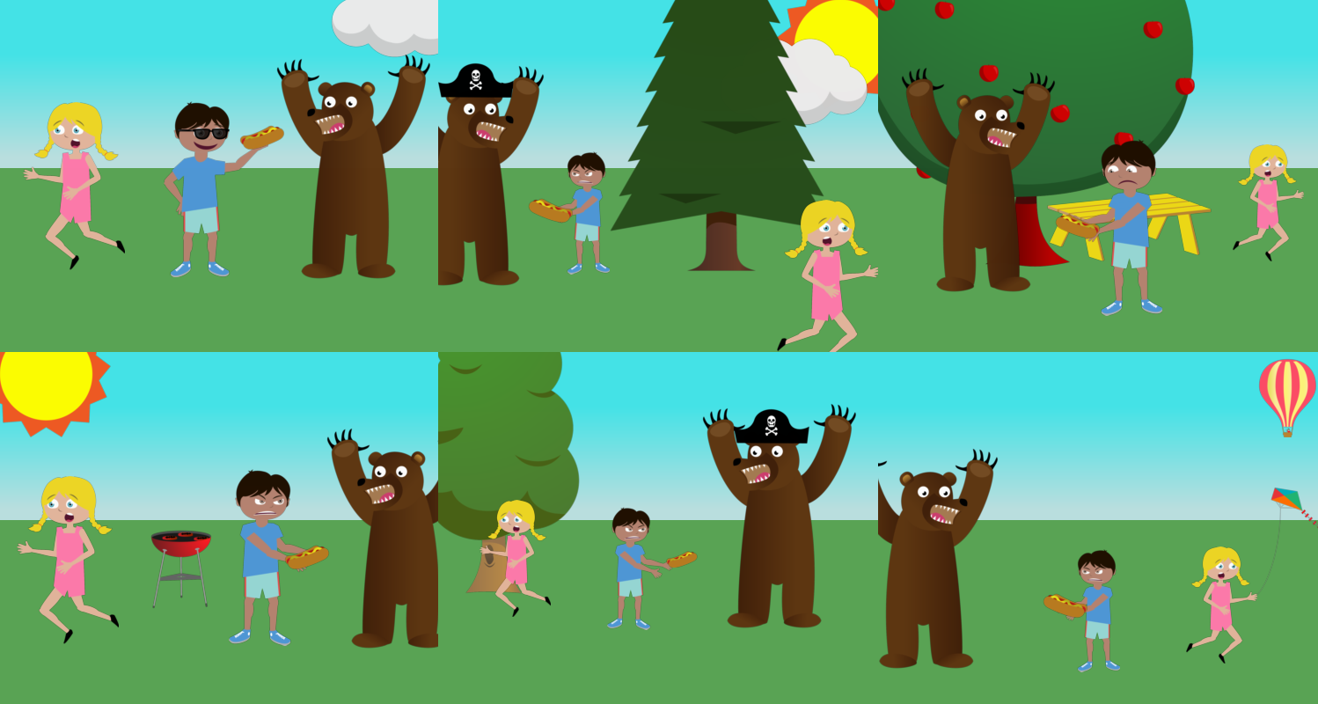
Mike fights off a bear by giving him a hotdog while jenny runs away.

Slide 17
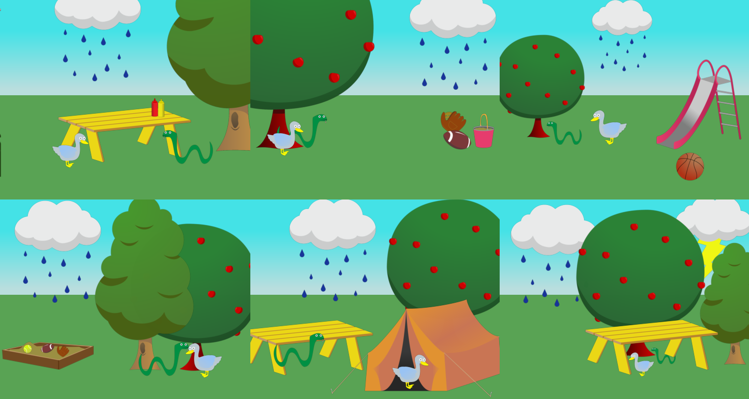
It was raining in the park and a duck and a snake were trying to take shelter.

Slide 18
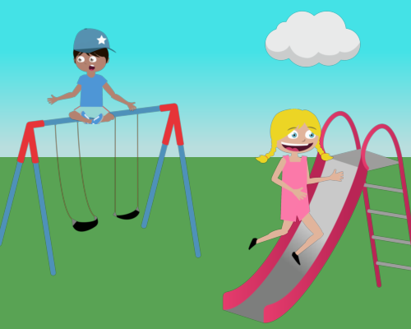
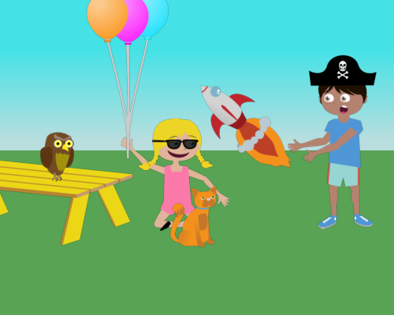
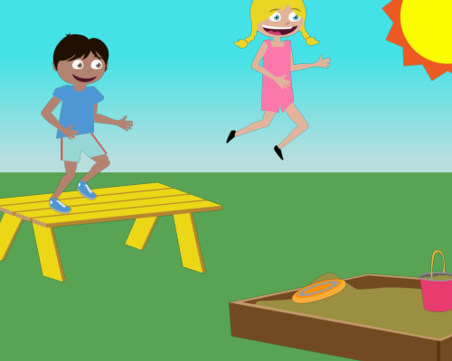
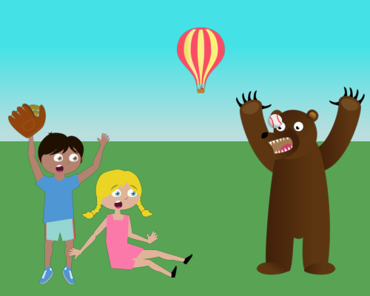
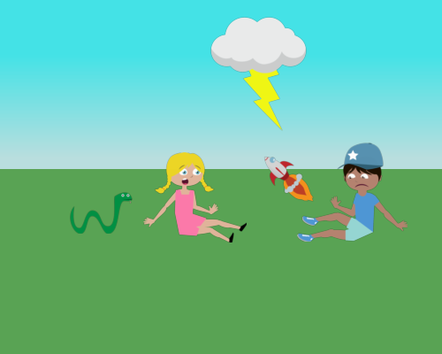
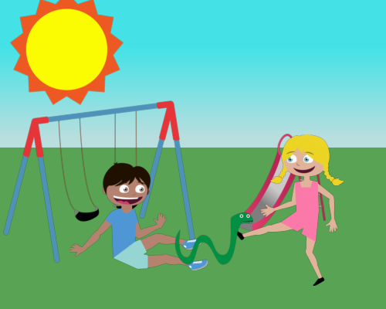
Jenny and Mike are both playing dangerously in the park.

Slide 19
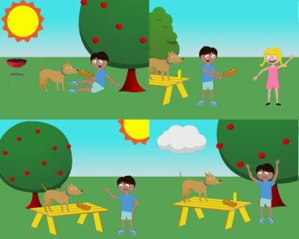


Semantic importance of visual features
1,000 classes of semantically similar scenes:
Class 1
Class 2
Class 1,000
1,000 classes x 10 scenes per class = 10,000 scenes

Slide 20
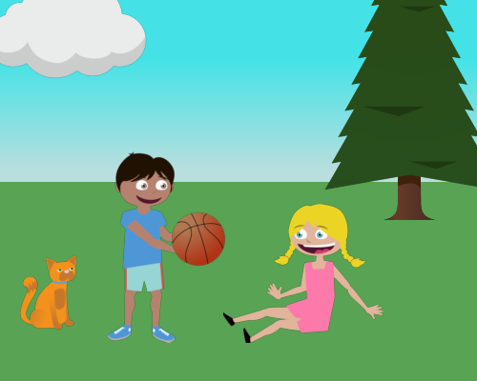
Visual features

Slide 21
Visual features
Cloud
Tree
Gaze
Smile
Gaze
Cat
Basketball
Person standing
Person sitting

Slide 22
Which visual features are semantically meaningful?
?
Absolute position
Absolute depth
Pose
Relative depth
Occurrence
Expression
Gaze
Relative position
Co-occurrence
Category vs. instance
Attachment to hand/head

Slide 23
Which words are visually meaningful?
?
Bike
Happy
Mike
Bear
Kicking
Very
Run
Face
Cloud
Distinguished
Vision
Cat
A
Today
Basketball
To
Help

Slide 24
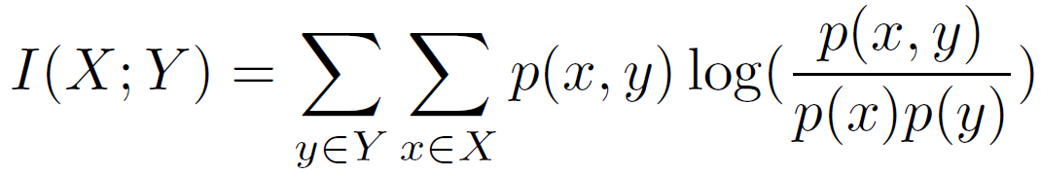
Mutual information
Semantic classes
Visual
features
Words

Slide 25
Information shared between:
Visual features
&
Semantic classes
Semantic classes
Visual
features
Words

Slide 26
Object occurrence

Slide 27














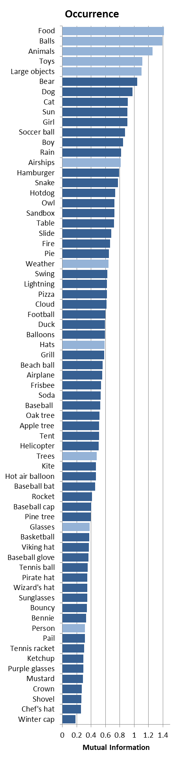
Object occurrence
High
Low
Mutual Information
Mutual Information

Slide 28
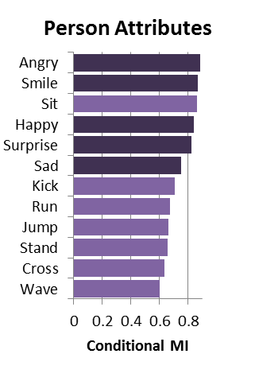


Person attributes

Slide 29


Relative spatial
Relative orientation is very informative.
≠

Slide 30
Information shared between:
Visual features
&
Words
Semantic classes
Visual
features
Words

Slide 31
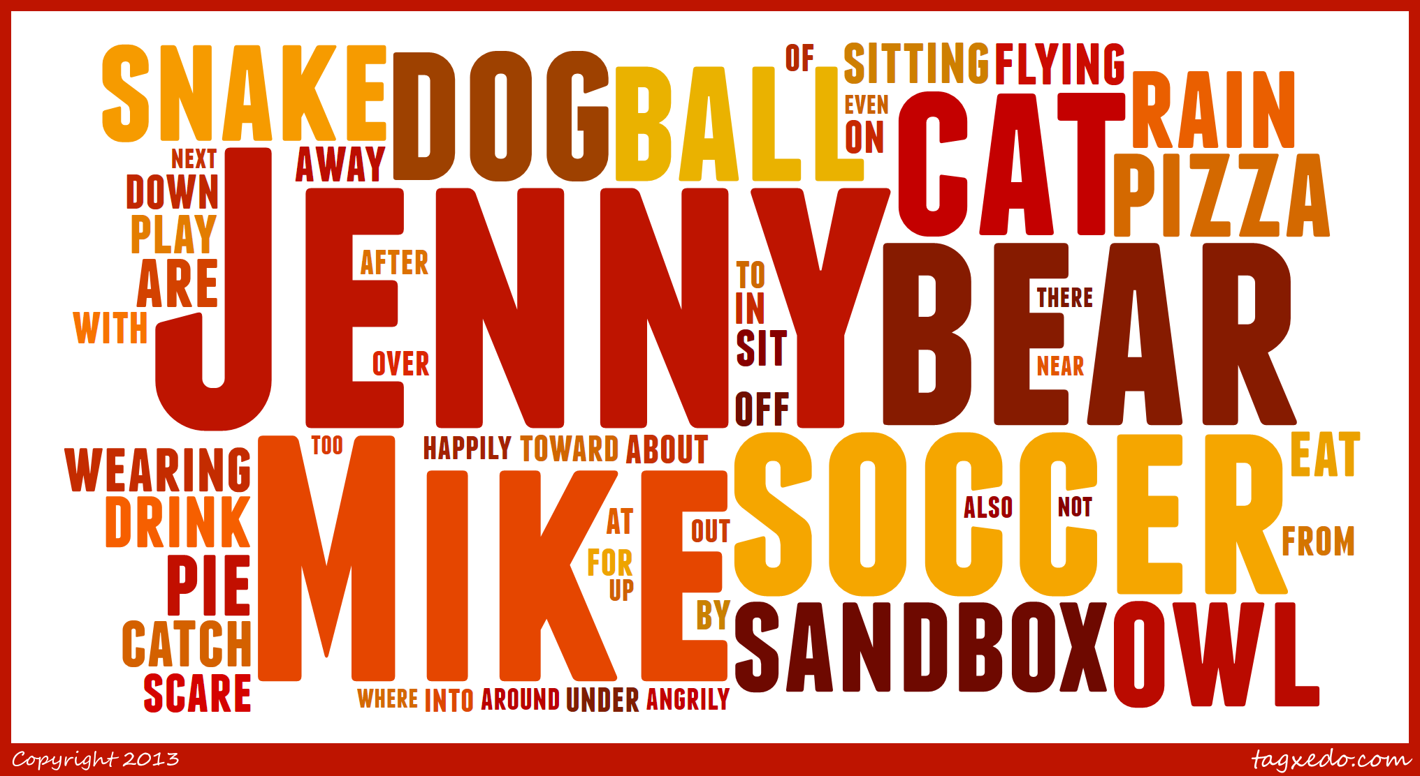
Most visually informative words

Slide 32

Least visually informative words
today
home
me
something
attention
using
isn’t
doing
went
give
behind
before
during
onto
through
how
since
why
finally
almost

Slide 33
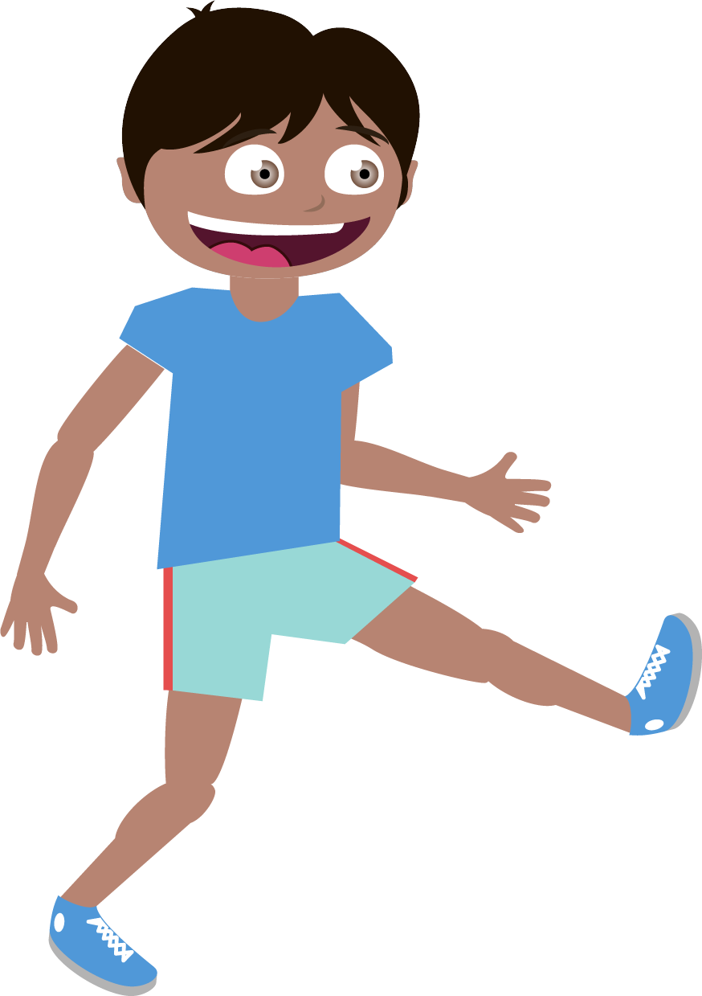

Most informative of relative position
bear
away
ball
soccer
kicking
Mike
from
on
his
to
he
him
holding
sandbox
a
playing

Slide 34




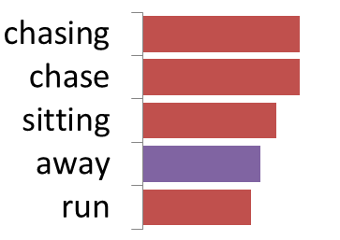
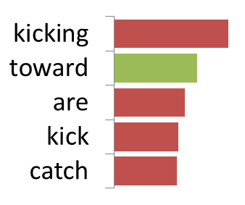
Most informative of relative position

Slide 35


What did we learn?
Occurrence of object instances provides significant semantic information
Frequency of occurrence ≠ semantic importance
Human expression and pose are important attributes
Occurrence of objects = nouns, while relative position is more predictive of verbs, adverbs and prepositions
Relative position is more important than absolute position
Co-occurrence of the boy/girl and animals are important
…
Duh, we already know that…
…but I didn’t.

Slide 36




What did we learn?
New approach to learning “common sense” knowledge about our world.
Goes beyond “Jenny and Mike.”

Slide 37
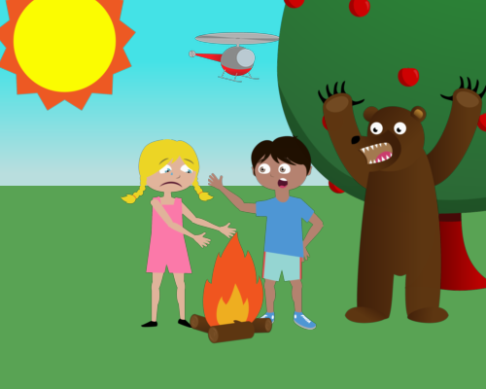

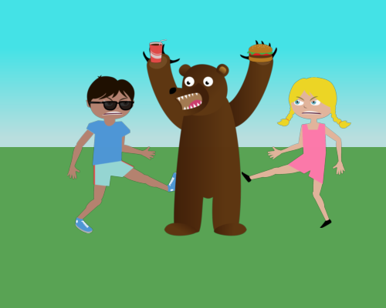
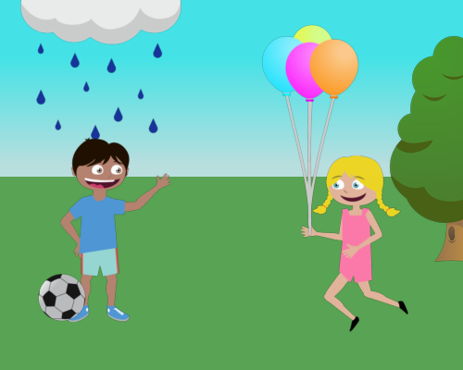




Don’t wait!
Jenny loves to play soccer but she is worried that Mike will kick the ball too hard.
Mike and Jenny play outside in the sandbox. Mike is afraid of an owl that is in the tree.
Jenny had a pie that she didn't want to share. That made Mike angry.
Mike's soccer ball almost got struck by lightening.
A cat anxiously sits in the park and stares at a unattended hot dog that someone left on a yellow bench.
Mike and Jenny are enjoying playing with a volleyball in the park.
Mike and Jenny are Playing pirates and their dog wants to play with the beach ball.
Mike and Jenny are laughing while they play with the frisbee.
'OH NO!" shouts Mike as Jenny runs from the green snake!
Jenny runs to ask mike if he can play tennis with her.
Mike and Jenny are playing catch with a football while a dog watches and a hot air balloon flies past them.
Jenny wants to play on the side but it's raining over there.
Jenny and Mike are having a great time in the sunny park as she pitches a baseball to Mike who is waiting with his bat.
Mike and Jenny are happy that it is finally time to eat!
Jenny is scared of a snake at their campsite but Mike wants to go catch it.
Mike was about to step into the sandbox when he saw there was snake in there.
Mike went down the slide too quickly and Jenny is worried that he is hurt.
Mike is sliding down the red slide and Jenny is asking him if he wants to play tennis or baseball.
Nobody is playing at the park because a thunder storm started and rain came pouring down.
Mike is so sad that he has to play alone.
Mike is sad that the hot dogs are burning on the grill! Jenny is happy just to have the sandwich and pizza.
Jenny is talking to an owl in the tree. The owl is actually a wizard that is disguised.

Slide 38




Dataset online
Thanks!
Special thanks to Bryan Russell, Lucy Vanderwende, Michel Galley, Luke Zettlemoyer

