Slide 1
Human-Debugging of Person Detection
Devi Parikh and Larry Zitnick

Slide 2
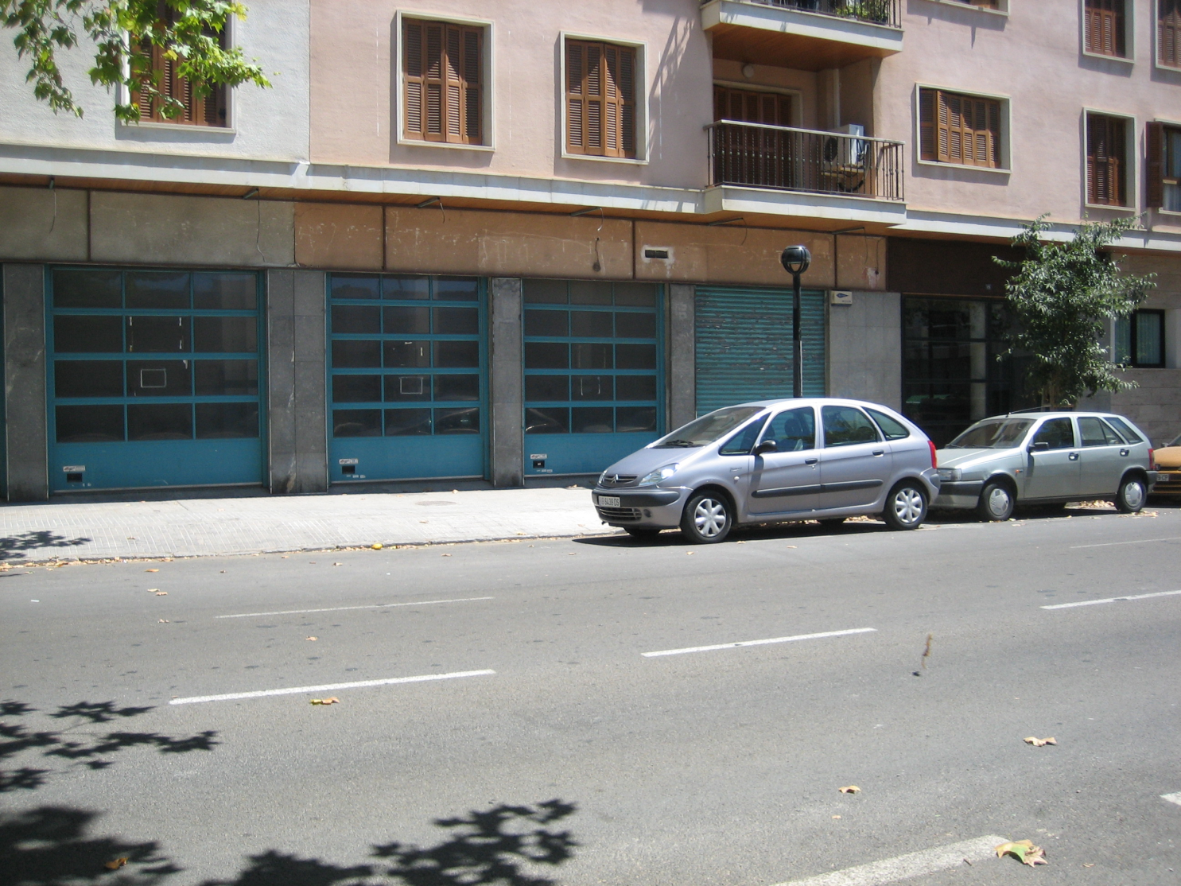
Computer Vision: Visual Recognition
Scene recognition
Object recognition
Object detection
WINDOWS
CAR
STREET

Slide 3
Computer Vision: Visual Recognition
Scene recognition
Object recognition
Object detection
Segmentation
WINDOWS
CAR
STREET

Slide 4
State of Machine Visual Recognition
Accuracy
Object Recognition
Scene Recognition
Object Detection
Segmentation
Machine
Human
…

Slide 5
State of Machine Visual Recognition
Accuracy
Complex systems: lot of progress
Where do we head next?
Machine
Human
Human-Debugging

Slide 6
Outline
Weakest Link in Person Detection
Challenges
Conclude

Slide 7
Person Detection
Useful
Challenging

Slide 8
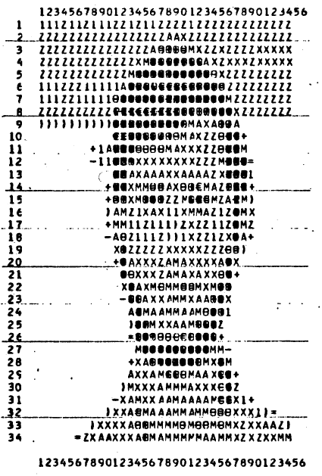
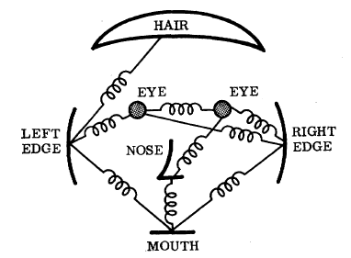
We’ve come a long way…
Fischler and Elschlager, 1973
Dollar et al., BMVC 2009

Slide 9
Still a long way to go…
Dollar et al., BMVC 2009

Slide 10
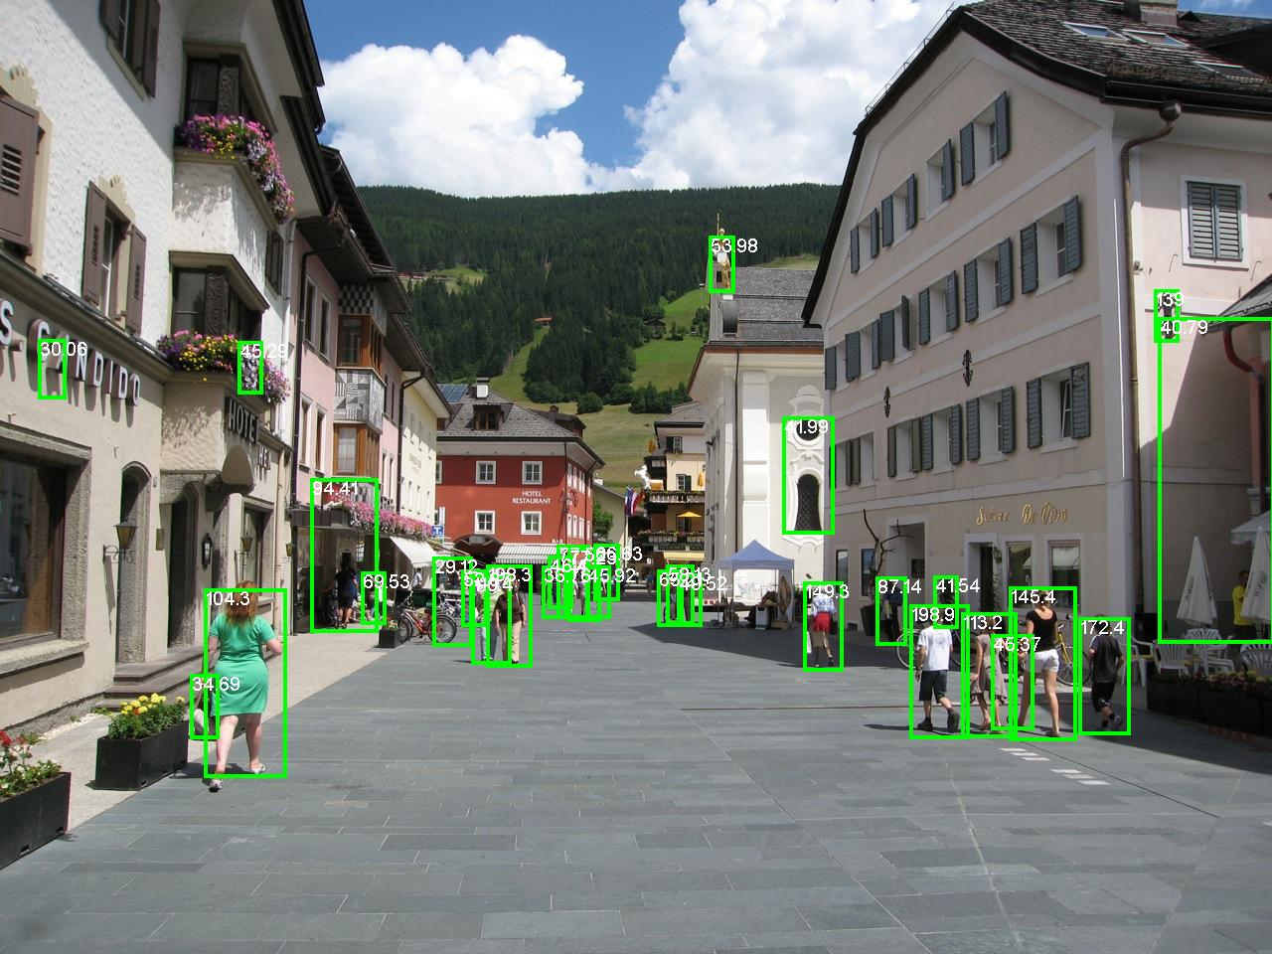
Dollar et al., BMVC 2009

Slide 11
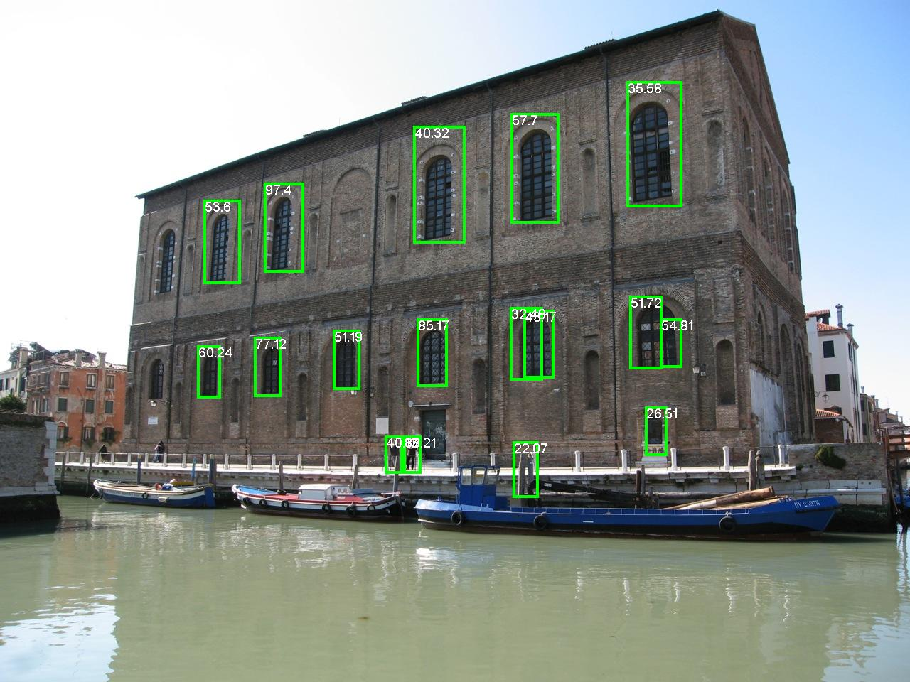
Dollar et al., BMVC 2009

Slide 12
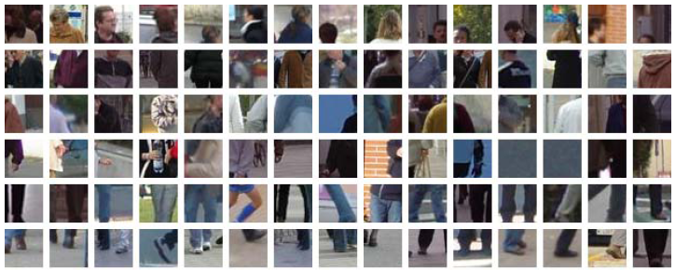
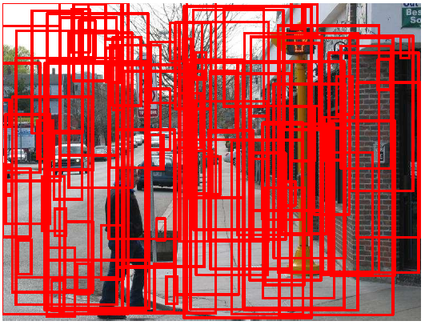
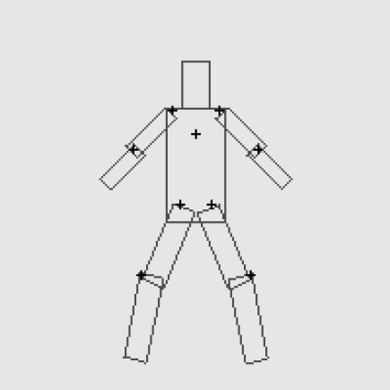
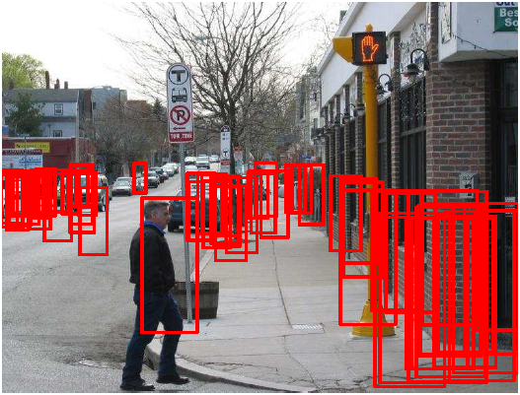
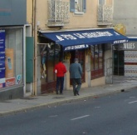
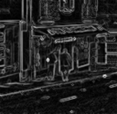
Person Detection System
Feature selection
Part detection
Spatial model
NMS / context
Color
Intensity
Edges
Hoiem et al., 2006
Felzenszwalb et al., 2005

Slide 13
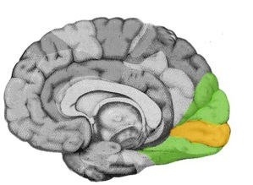
Human-Debugging
Feature selection
Part detection
Spatial model
NMS / context
Feature selection
Spatial model
NMS / context
Feature selection
Part detection
NMS / context
Feature selection
Part detection

Slide 14
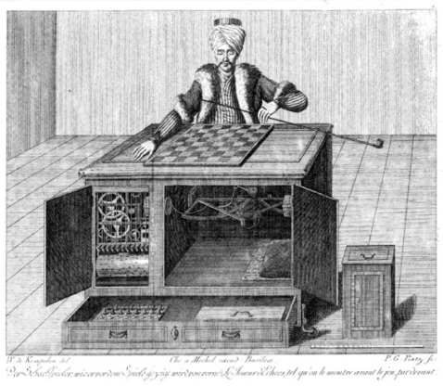
Human-Debugging
F
P
SM
NMS
Machine
Human
Amazon Mechanical Turk

Slide 15
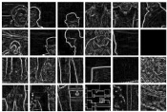
Human-Debugging
F
P
SM
NMS

Slide 16
Human-Debugging
F
P
SM
NMS

Slide 17
Human-Debugging
F
P
SM
NMS

Slide 18
Human-Debugging
F
P
SM
NMS

Slide 19
Human-Debugging
F
P
SM
NMS

Slide 20
Human-Debugging
F
P
SM
NMS

Slide 21
Human-Debugging
F
P
SM
NMS

Slide 22
Human-Debugging
F
P
SM
NMS

Slide 23
Human-Debugging
F
P
SM
NMS

Slide 24
Human-Debugging
F
P
SM
NMS
Person
Not a person

Slide 25
Human-Debugging
F
P
SM
NMS

Slide 26
Part Patch Dataset

Slide 27
Part Patch Dataset

Slide 28
Part Patch Dataset
Human face detection

Slide 29
Part Patch Dataset
Human torso detection

Slide 30
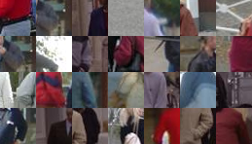
Part Patch Dataset
Human arm detection

Slide 31
Part Patch Dataset
Human hand detection

Slide 32
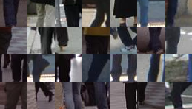
Part Patch Dataset
Human leg detection

Slide 33
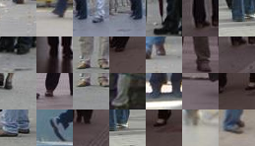
Part Patch Dataset
Human foot detection

Slide 34
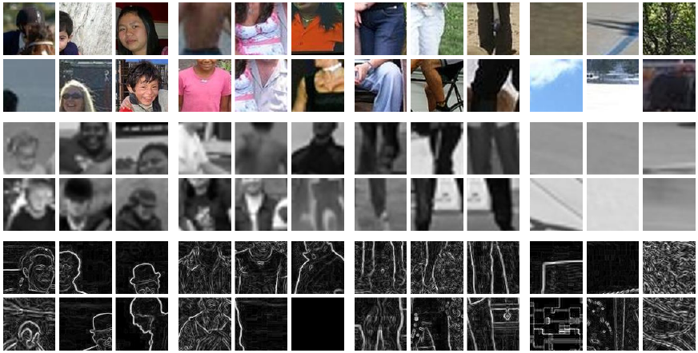
Part Patch Dataset
0.3 million patches
10 subjects
6 Parts and Root
Regular, Gray-scale, Normalized-gradient
High and Low resolution
Available online!

Slide 35
Parts-based Object Detectors
F
P
SM
NMS
Machine
Human

Slide 36
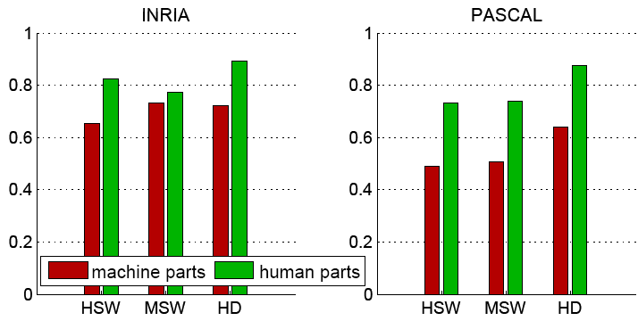
Results (P)

Slide 37
Part Visualizations

Slide 38
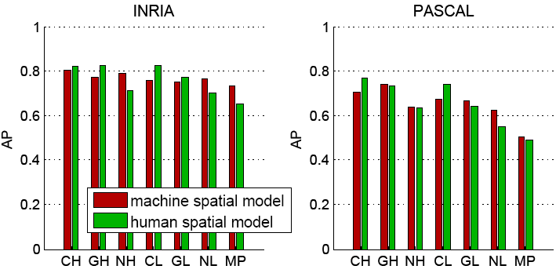
Results (SM)

Slide 39
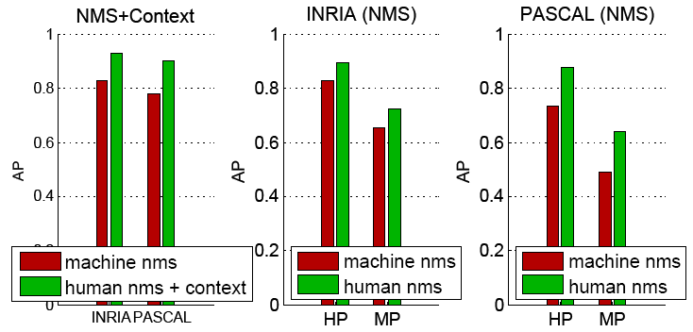
Results (NMS)

Slide 40
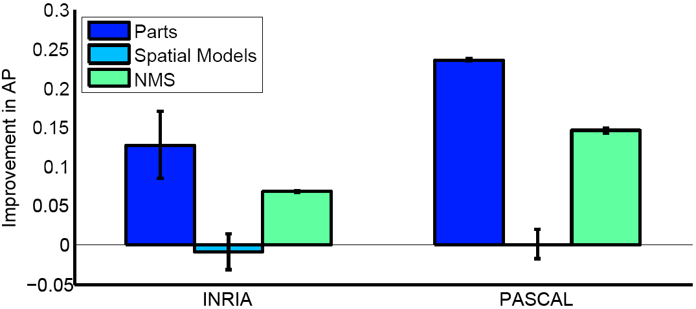
Results
Classify 24x24 patches into one of 6 part categories (+background)

Slide 41
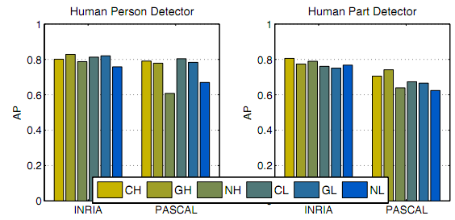
Effect of Features (F)

Slide 42
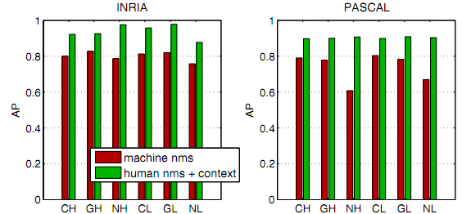
Effect of Context

Slide 43
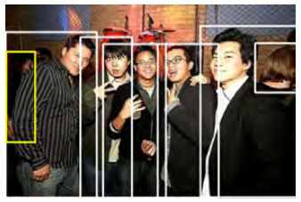
Sources of Error
Notes:
Even when subjects are shown the entire image, highly occluded people in bad lighting are missed.

Slide 44
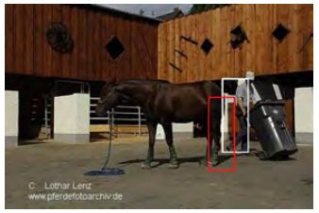
Sources of Error
Notes:
When subjects classify windows in isolation from the rest of the image as containing a person or not, lack of context leads to false positives when the windows locally appear to have parts of a person

Slide 45
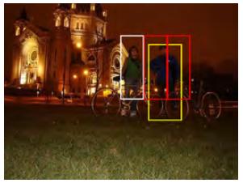
Sources of Error
Notes:
A machine spatial model applied to near-perfect human part-detections fails because of symmetric part detections. Subjects were asked to classify patches as containing arms, legs, etc. and were not asked to distinguish between left/right arms, legs, etc.

Slide 46
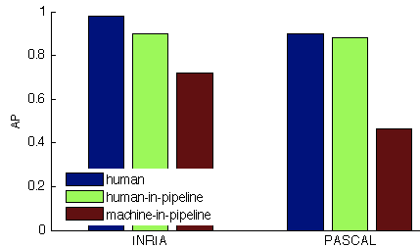
Human-Debugging
Importance of each component
Potential of pipeline as a whole

Slide 47
Challenges

Slide 48
Challenges
Accessing isolated human models
Visualizing high-dimensional data
Invoking natural visual pathways
[Chernoff, 1973]

Slide 49
Conclusion
Accuracy
Humans are a working system!
Interactive
Figure our brains out
Label training data
Design algorithms
Debug our systems!
Machine
Human

Slide 50
Thank you!

